Slide 1
Making H105 a smart classroom
DASS Project no.: 36, Team no.: 21

Slide 2
Client: Vishal Garg
Mentors:
- Simran Singhal (Appointed by client)
Lakshmi Sireesha Vakada (TA)
Team Members:
- Vishal Verma
- Akash Verma
- Archit Goyal
- Priyanshu Madaan

Slide 3
About The Project

Slide 4
Tasks in making H105 a smart classroom
Automating Lights on the basis of occupancy.
Deploying sensors to measure enviroment parameters of classroom.
Automating AC’s and evaporators on basis of sensors’ data.
Automating Projector to follow instructors voice command.

Slide 5
Timeline
Developing Hardware
Android Application + Backend
1-Feb-2020
29-Feb-2020
10-March-2020
23-March-2020
30-March-2020
1
2
3
4
5
Survey Of Classroom + Project Plan
Algorithm Design For Smart Control
Testing + Deployment

Slide 6
Progress Log
 | Tasks | Status
Sprint 1 | Study About Smart Classrooms and automation techniques and ESP32 and Hardware | Completed
Sprint 2 | Survey Electrical, physical, AC and evaporator Layout of the H-105 | Completed
Sprint 3 | Developing hardware (Sensor circuits, lighting circuits) | Under Process
Sprint 4 | Training and Testing B1 Hub and developing API’s for B1 Hub | Completed
R1 | Sending data from sensors to server and generating API’s to fetch that data for future use . | Under Process

Slide 7
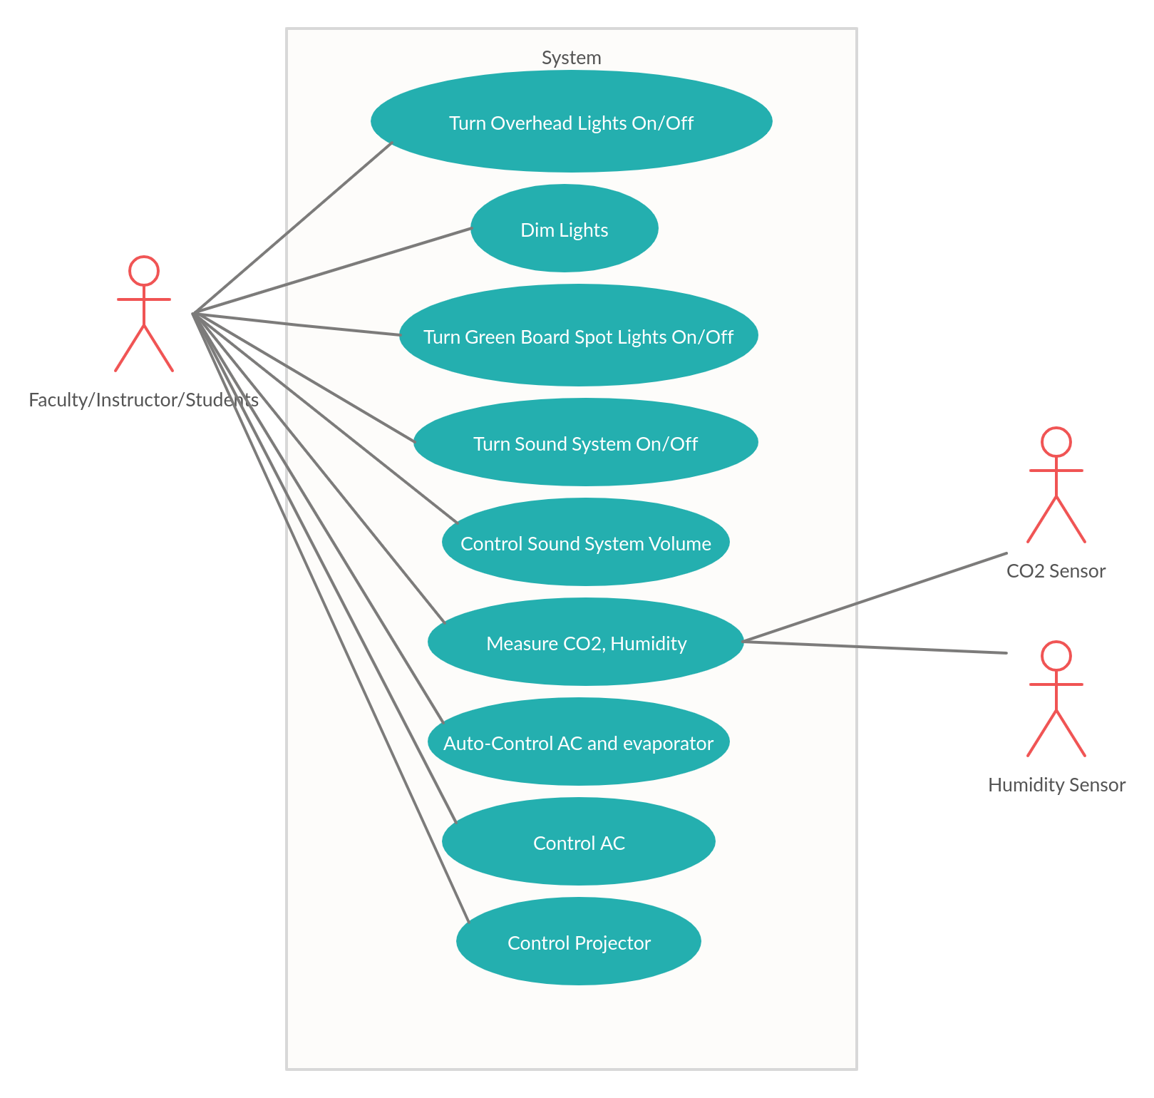
UML UseCase Diagram

Slide 8
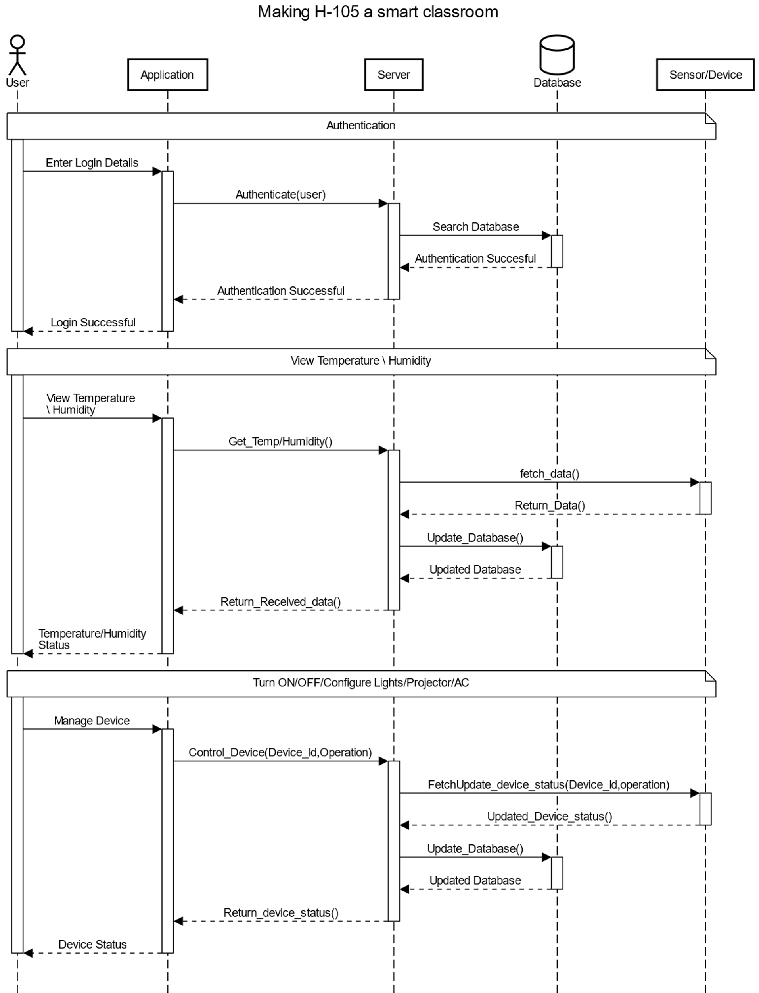
UML Sequence Diagram

Slide 9
Features

Slide 10
Automating Lights

Slide 11
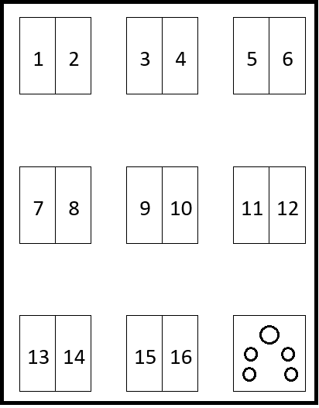
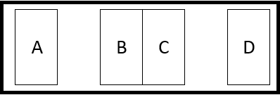
Electrical Layout Of H-105
Switch Board Layout

Slide 12
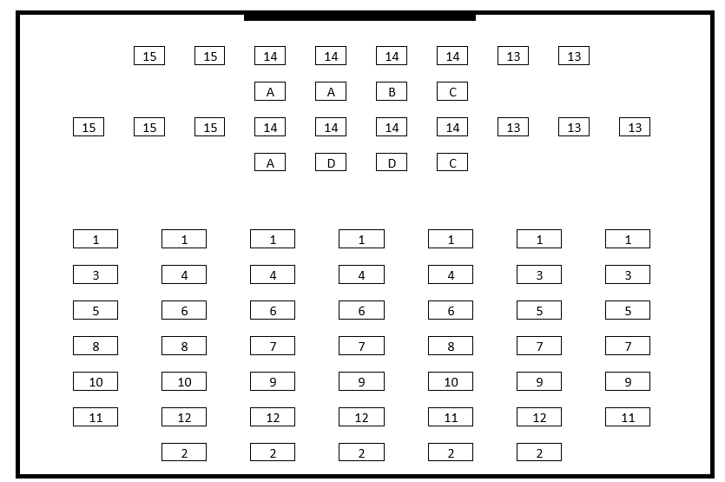
Electrical Layout Of H-105
Light Fixture Layout

Slide 13
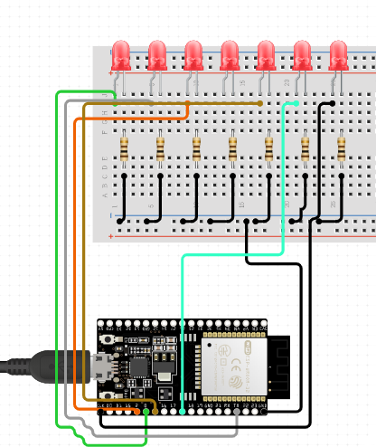
Controller Circuit
Components Used:
ESP32 Development Board
LED
Resistors
Jumper Wires

Slide 14
Basic Web App To Control The Lights

Slide 15
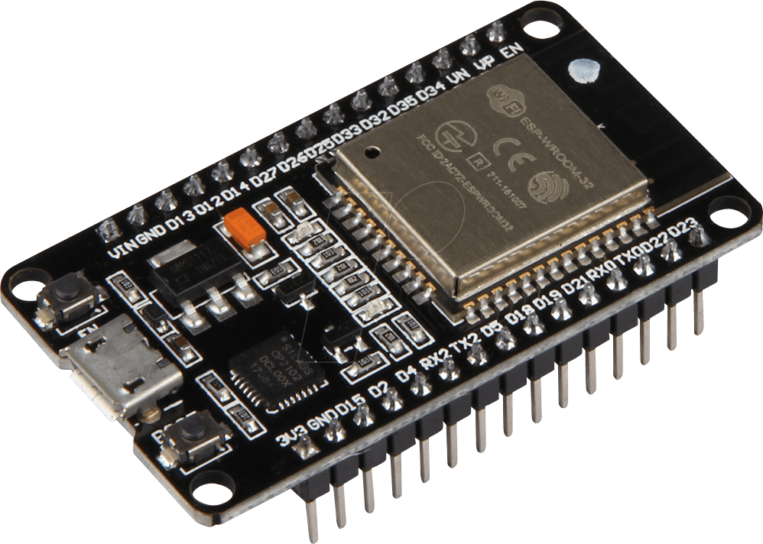

Control Flow
Server Backend
Web App

Slide 16
Sensors
For measuring the environment parameters of classroom and outside the classroom.

Slide 17
Sensors Used:
Humidity Sensor
CO2 Sensor
It will be measuring the relative humidity inside the classroom and outside the classroom. And will be sending the measured data to server which will be further used to control evaporators.
It will be measuring the CO2 inside the classroom and will send data to server which can be further used to control the evaporators and measure the occupancy of the classroom.

Slide 18
Sensors Used:
Energy sensors
Temperature sensor
It will measure the energy used by devices in H-105 which can be further used to analyse the efficiency of devices and hence to save the energy.
It will be measuring the temperature inside the classroom and outside the classroom. And will be sending the measured data to server which will be further used to control AC’s.

Slide 19
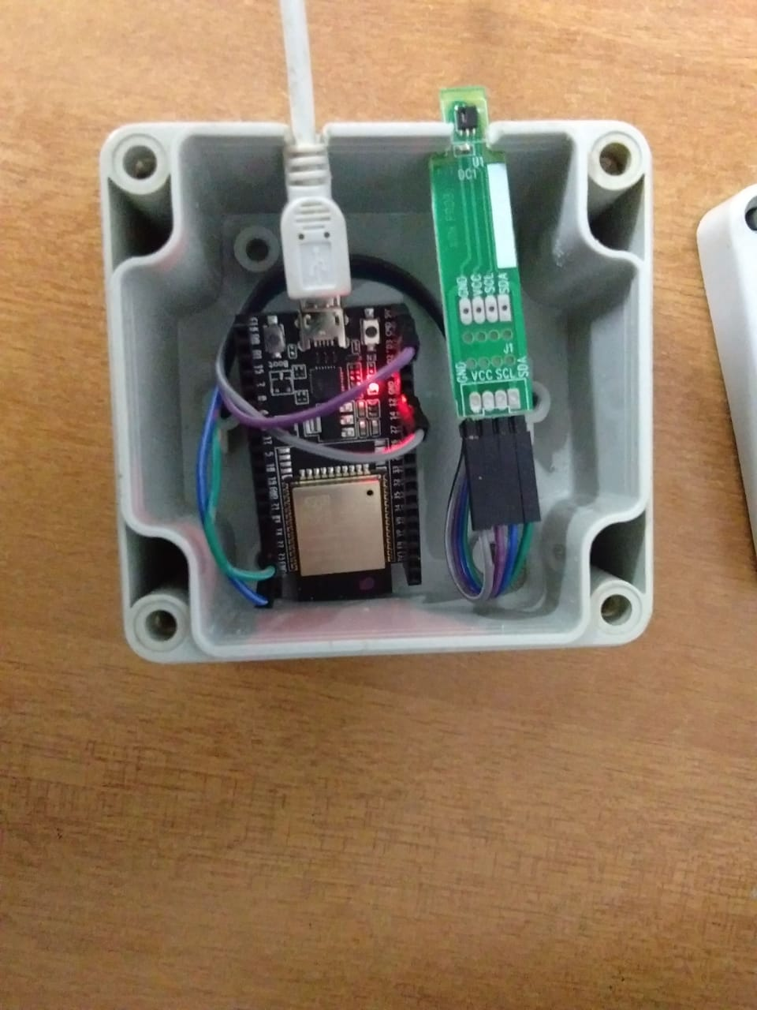
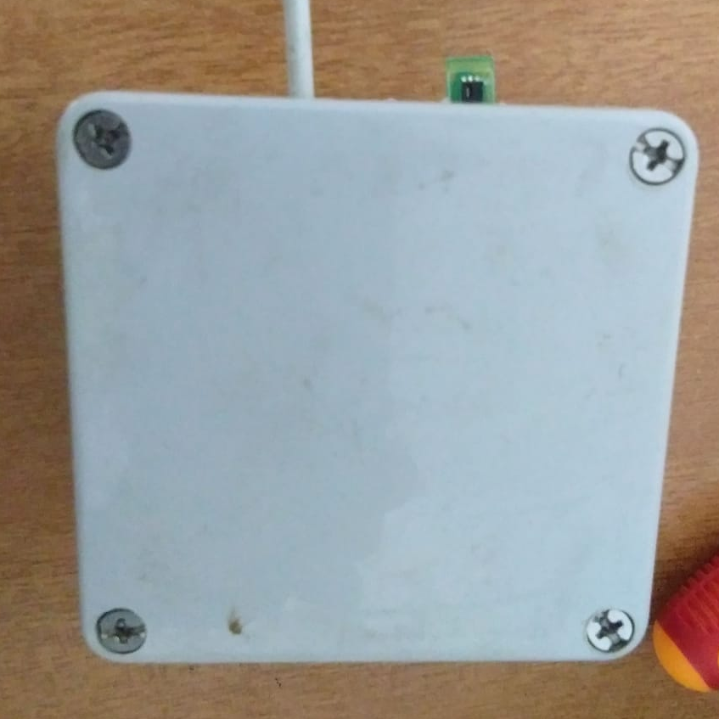
Temperature and Humidity sensor circuit
We coded on Aurduino IDE and conncetd sensor to sevrer to send the data on the server using API’s. From where data can be used using API’s.
You can find data sent by circuit on this link
https://thingspeak.com/channels/1005926/.

Slide 20

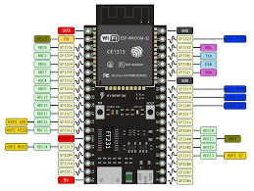
CO2 sensor circuit
The circuit is not working and is under development due to damaged sensors which is to be replaced by client. So no output can be found.

Slide 21
Energy sensor circuit
Sensors yet to provided by client.

Slide 22
Automating AC’s & Projector

Slide 23
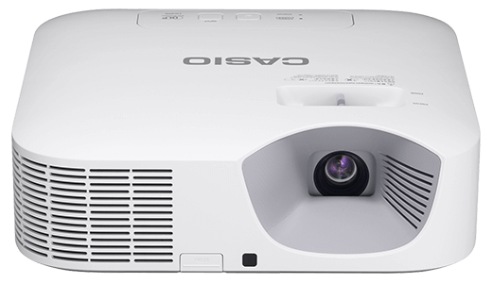

Projector :
AC :

Slide 24

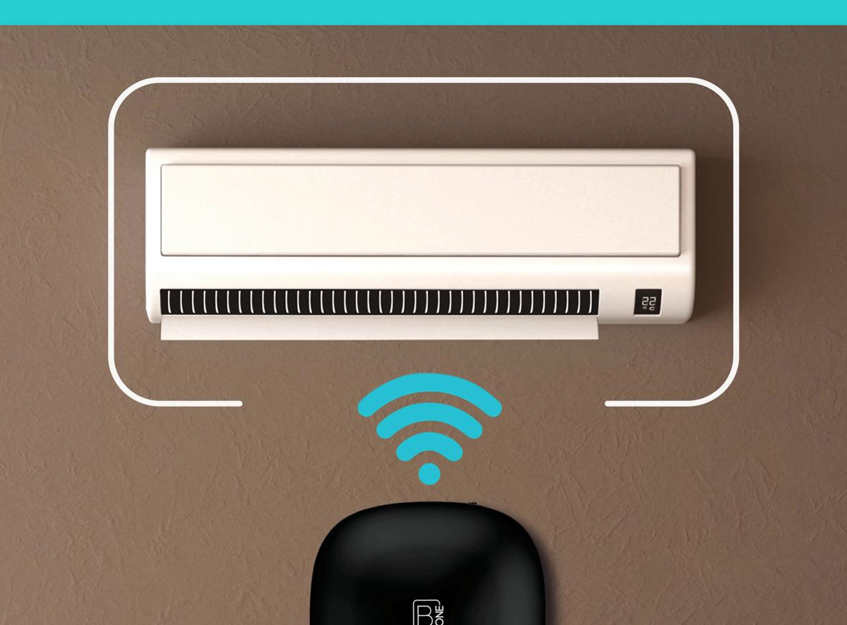
B ONE hub

Slide 25
B one Hub
Sends IR signals to control devices which work on remote.
Can control various IR supported home appliances, AC’s, Projectors etc.

Slide 26
What we did in our project ?
We made the backend in “Express js”.
which makes a “POST” request on “B1 hub open API”, which further sends a signal (or command) to our “B1 one hub device” which further sends an “IR signal” to the device which we want to control.
Deployed on “HEROKU” Online web server.

Slide 27
FEATURES OF AC & PROJECTOR CONTROLLED THROUGH “B one HUB” & Backend :
AC :
“ ON/OFF ”
Temperature :
“ Temp + ” , “ Temp – ”
Modes :
COOL, DRY, SWING, FAN
PROJECTOR :
“ ON/OFF ”

Slide 28
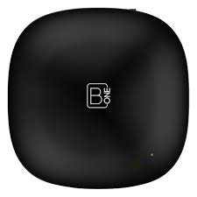
B one Hub API
Heroku
Post
Request

Slide 29

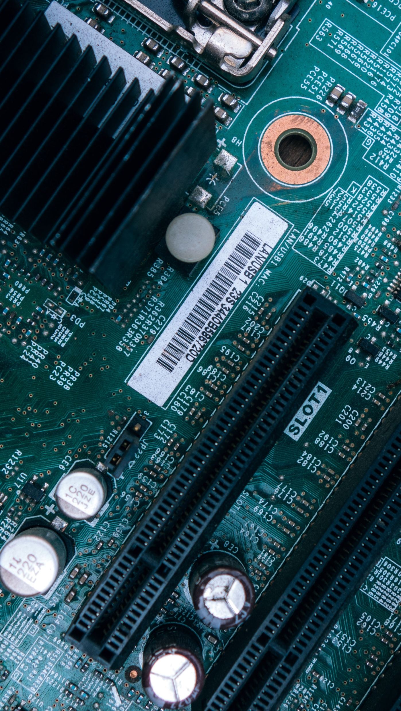
Mobile App
We will be using android app to automate the devices.
It will be done in later stages of this project.

Slide 30
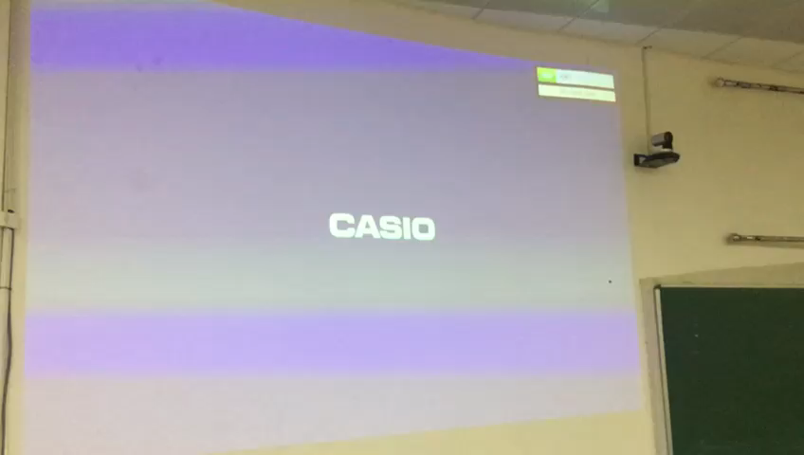
Working proof of PROJECTOR

Slide 31
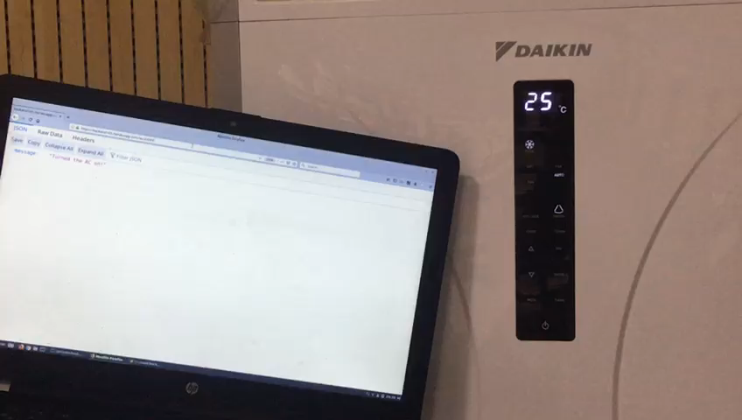
Working proof of AC

Slide 32
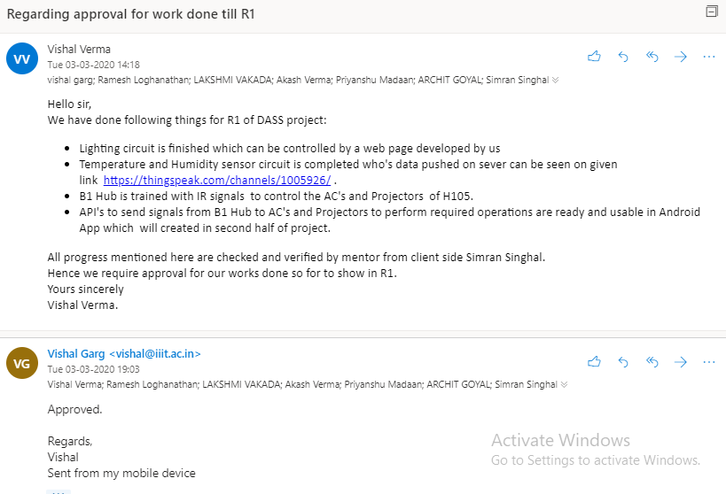
Client Feedback

Slide 33
Link to R1 Presentation Video
https://drive.google.com/file/d/1oGWTlj-5YUx9x5VTp1ge5nhLe82Atx67/view?usp=sharing

Slide 34
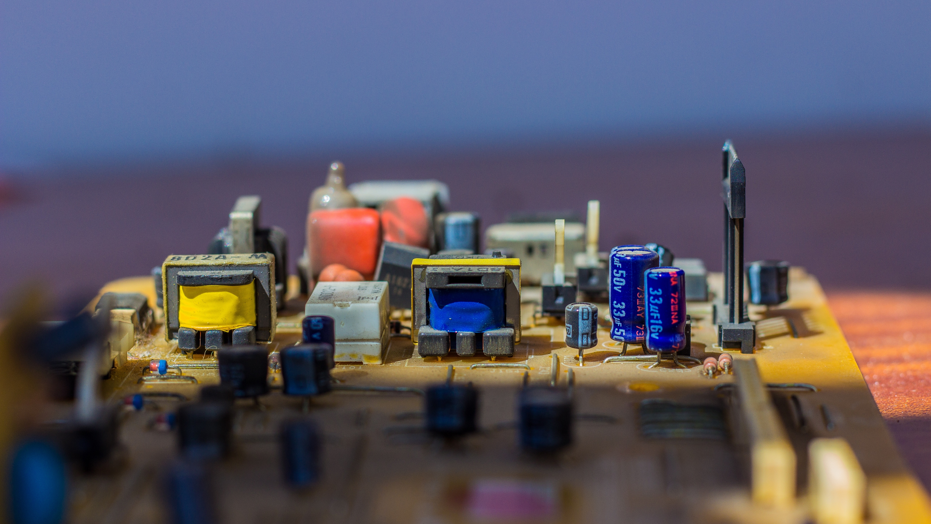
Thank You

